Slide 1
IoT Prototyping Laboratory
Vipul Singh Negi

Slide 2
Team Code: 3mlkt3i
Please join the above MS Team

Slide 3
Microcontrollers
Memory
ROM RAM
CPU
I/O
Subsystems:
Timers, Counters, Analog
Interfaces, I/O interfaces
A single chip

Slide 4
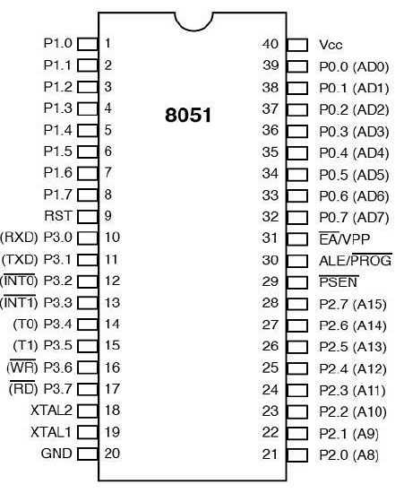
Pin Diagram

Slide 5
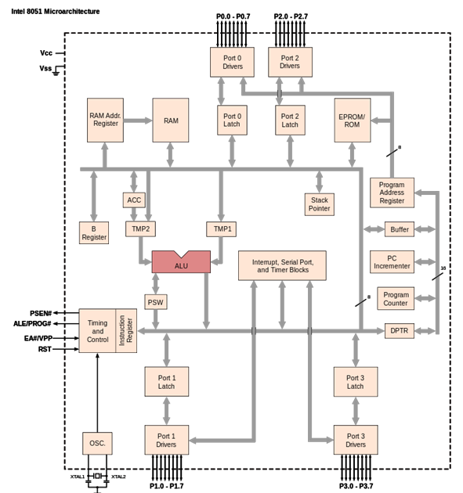
Architecture

Slide 6
Ports
PORT P1 (Pins 1 to 8): The port P1 is a port dedicated for general I/O purpose. The other ports P0, P2 and P3 have dual roles in addition to their basic I/O function.
PORT P0 (pins 32 to 39): When the external memory access is required then Port P0 is multiplexed for address bus and data bus that can be used to access external memory in conjunction with port P2. P0 acts as A0-A7 in address bus and D0-D7 for port data. It can be used for general purpose I/O if no external memory presents.
PORT P2 (pins 21 to 28): Similar to P0, the port P2 can also play a role (A8-A15) in the address bus in conjunction with PORT P0 to access external memory.

Slide 7
Contd.
PORT P3 (Pins 10 to 17):
In addition to acting as a normal I/O port,
P3.0 can be used for serial receive input pin (RXD)
P3.1 can be used for serial transmit output pin (TXD) in a serial port,
P3.2 and P3.3 can be used as external interrupt pins (INT0’ and INT1’),
P3.4 and P3.5 are used for external counter input pins (T0 and T1),
P3.6 and P3.7 can be used as external data memory write and read control signal pins (WR’ and RD’) read and write pins for memory access.

Slide 8
Installation
Navigate to https://sourceforge.net/projects/edsim51/
Download the file.
Install Java (Download x64 for Windows and can choose for Mac).
https://www.java.com/en/download/manual.jsp
If you are on Linux (Ubuntu), use
sudo apt install default-jdk
Install Java.
Unzip the EdSim51 File and open the .jar file.

Slide 9
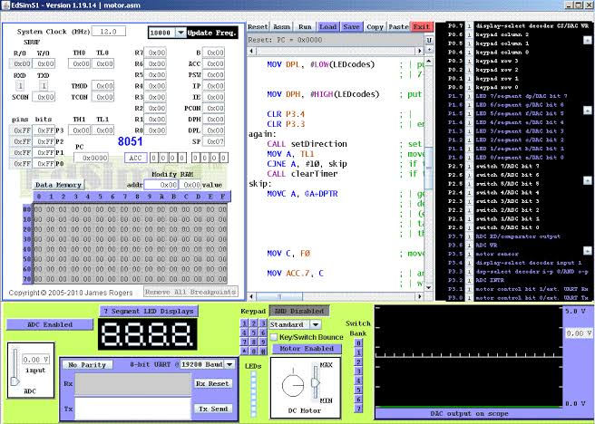

Slide 10
First Code
Org 00H ; Start of Program
Start: Mov A, #0FH ; This is comment. Move copies the value
Mov P1, A
End
Org: Is the Origin of the program. It tells us where in the memory the program starts.
End: Is used to inform that the program is ending.

Slide 11
Instructions for 8051
[label:] mnemonic [operands] [; comments]
Example: Start: Mov A,#0FH ; This copy data into A
Label Instructions Comments
Opcode Operand
Mov A,#0FH

Slide 12
The First code in memory
This link contains 8051 instructions by HEX code.
https://www.keil.com/support/man/docs/is51/is51_opcodes.asp?bhcp=1
74 0F
F5 90
The above values are the hex values in the data memory for the first code.

Slide 13
Second Code
Org 00H
Start: Mov A, #05H
Add A, #010H ; Add the value in the accumulator
End
This is the Accumulator adding two values

Slide 14
DIY
Do the multiplication of 2 numbers.

Slide 15
Multiply two values
Org 00H
Start: Mov A, #03H
Mov B, #02H
mul ab ; A and B are multiplied
End

Slide 16
Immediate Data movement
Org 00H
Start: ; Immediate Data (Constants) - REQUIRES '#'
MOV A, #45H ; Load Hex value 45 into Accumulator
MOV R0, #10 ; Load Decimal value 10 into Register R0
MOV DPTR, #1234H ; Load 16-bit address into Data Pointer
End

Slide 17
Direct Addressing
Org 00H
Start: ; Direct Addressing (RAM / Registers / Ports) - NO '#'
0000| MOV A, P2 ; Copy 8-bit input from Port 2 into Accumulator
0002| MOV P1, A ; Send Accumulator bits out to Port 1 LEDs
0004| MOV R1, 30H ; Copy content of RAM location 30H into R1
End

Slide 18
Indirect Addressing
Org 00H
Start: ; Indirect Addressing (Pointers) - USES '@'
0000| MOV A, @R0 ; Read RAM byte whose address is stored inside R0
0001| MOV @R1, A ; Write Accumulator byte into RAM address stored in R1
End

Slide 19
Number System
MOV A, #0FFH ; Hexadecimal (Must start with a digit 0-9 if starting with A-F)
MOV A, #11001010B ; Binary (suffix 'B')
MOV A, #255 ; Decimal (no suffix)
MOV A, #'A' ; ASCII character (evaluates to 41H / 65)

Slide 20
Binary Pattern in Port 1 LEDs
org 00h
start:
DEC P1 ;Decrease
JMP start ; Jump back to the start variable
end

Slide 21
Contd.
DEC P1
DEC (Decrement): Subtracts 1 from the 8-bit value inside Port 1 (P1).
On reset, all port pins default to high/1s (FFH or 11111111B).
1st run: P1 drops from 11111111B (FFH) to 11111110B (FEH).
2nd run: Drops to 11111101B (FDH).
3rd run: Drops to 11111100B (FCH), and continues counting down to 00000000B before rolling back over to 11111111B.
JMP start
JMP (Unconditional Jump): Forces the 8051 to jump back to the start: label, forming an infinite loop that keeps decrementing P1 forever.

Slide 22
Switching LED’s on Click
org 00h
start:
MOV P1, P2 ; move data on P2 pins to P1
JMP start ; and repeat
end

Slide 23
Assignment
Do the subtraction of 2 numbers.
Do the division of 2 numbers.
Do addition with carry.
Do subtraction with borrow.

